Slide 1
WIRELESS EMBEDDED SYSTEM Introduction to ESP32
Doan Duy, Ph. D.
Email: duyd@uit.edu.vn

Slide 2
Objectives
Getting to know about ESP32
Example of applying ESP32

Slide 3
Content
Watching video about ESP32 application
Features of ESP32
Documents

Slide 4
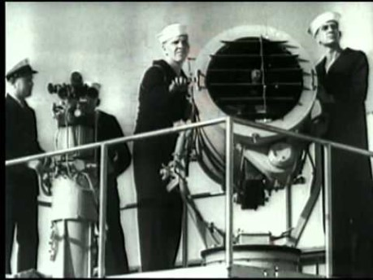
Wireless History

Slide 5
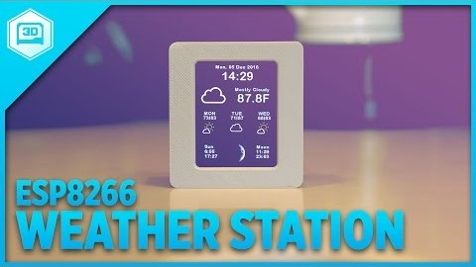
ESP32 Weather Station

Slide 6
Introduction to ESP32

Slide 7
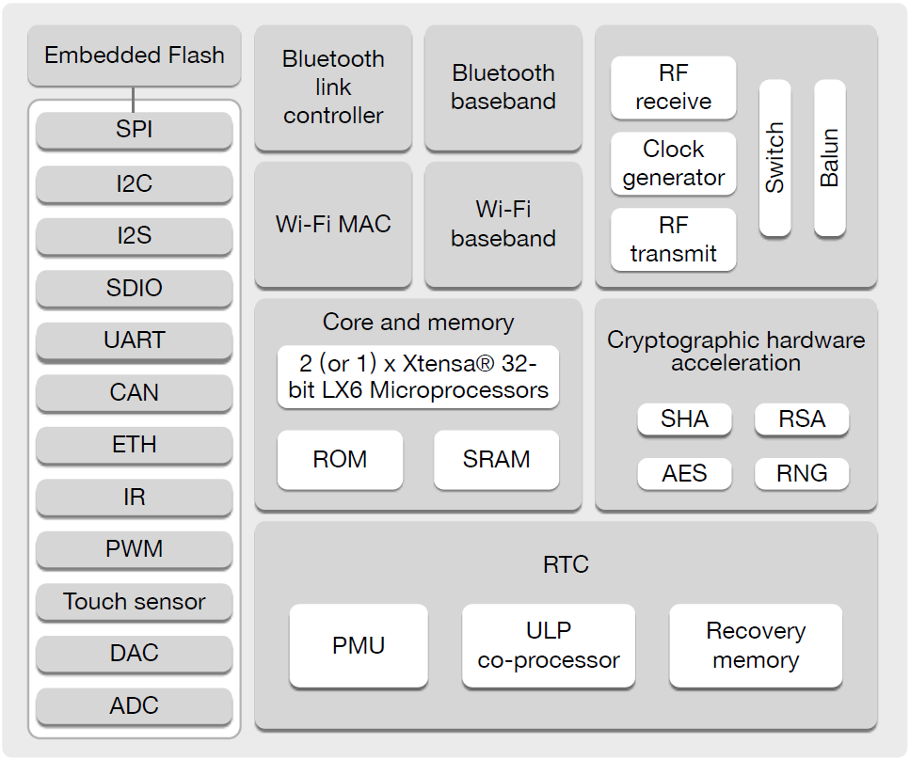
Block Diagram

Slide 8
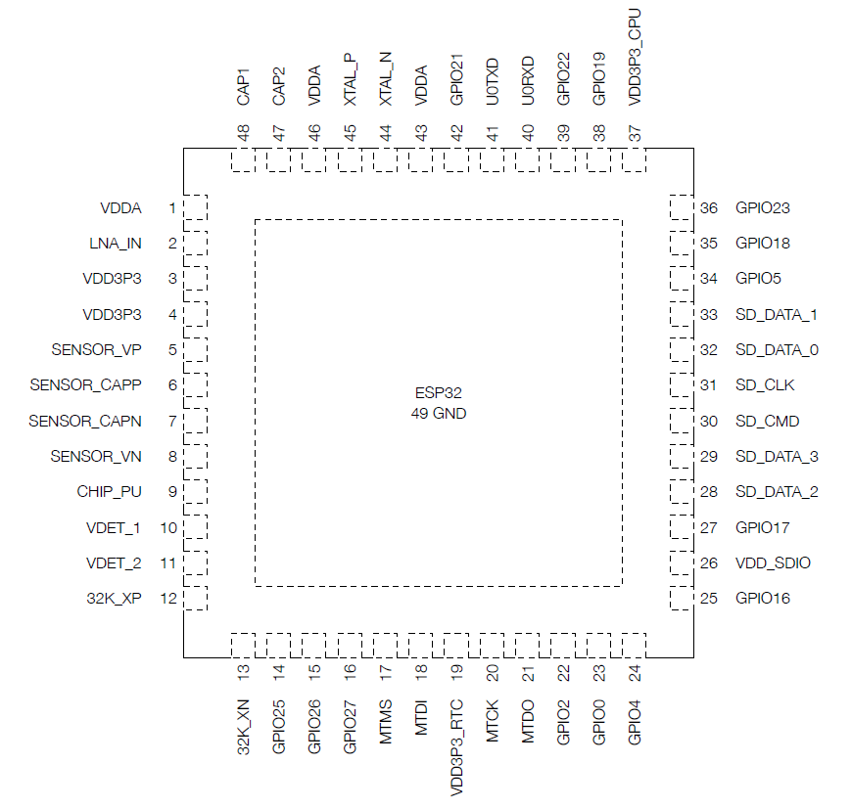
ESP32 Pins

Slide 9
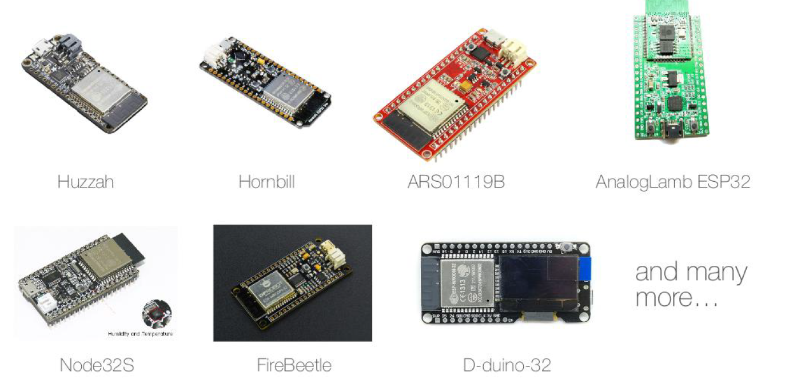
ESP32 Modules

Slide 10
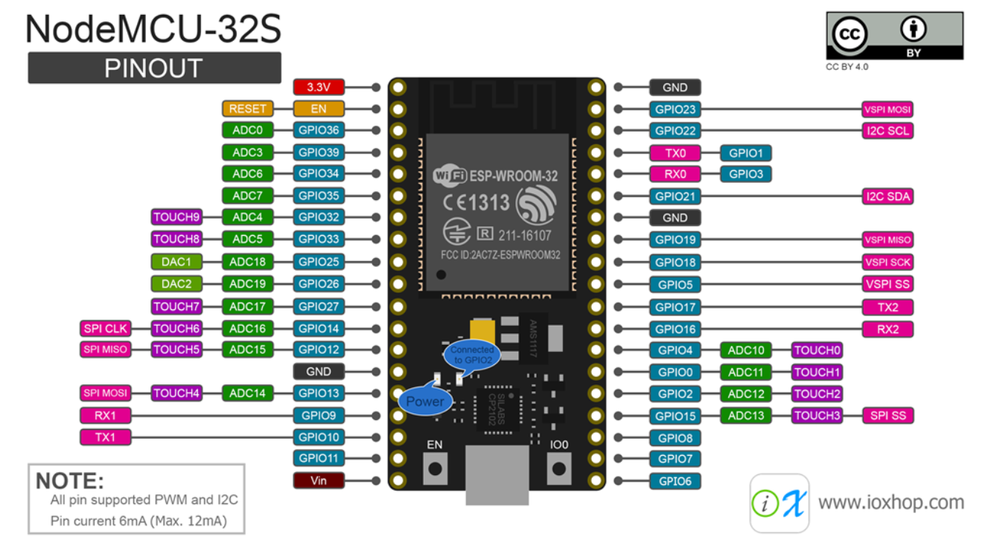
Wi-Fi NodeMCU-32S WROOM

Slide 11
Overview of ESP32
ESP32 is a single 2.4 GHz Wi-Fi-and-Bluetooth combo chip
Process: TSMC ultra-low-power 40 nm technology.
The best power and RF performance, showing robustness, versatility and reliability.
The ESP32 series of chips includes ESP32-D0WDQ6, ESP32-D0WD, ESP32-D2WD, and ESP32-S0WD.
ESP32 is designed for mobile, wearable electronics, and Internet-of-Things (IoT) applications.

Slide 12
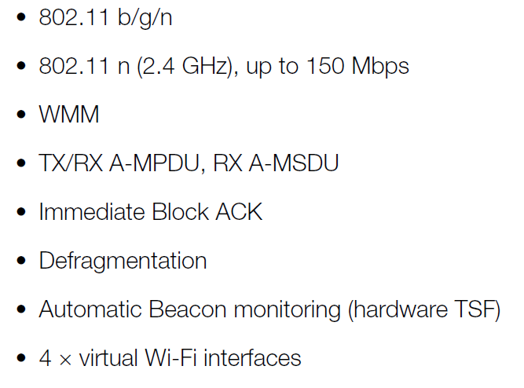
Wifi Key Features
• Support for Infrastructure Station, SoftAP, and Promiscuous modes
• Antenna diversity

Slide 13
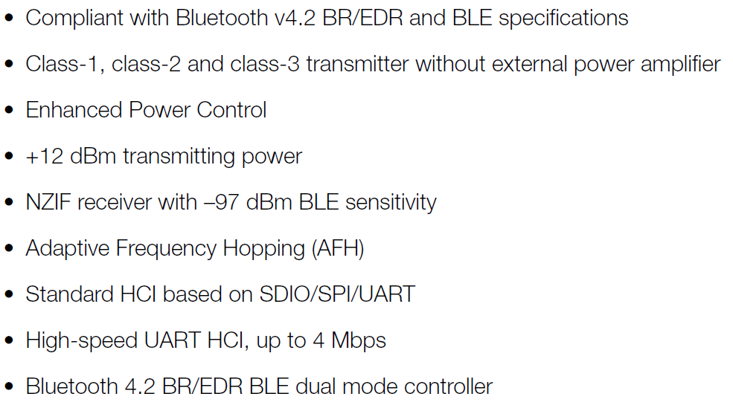
Bluetooth Key Features

Slide 14
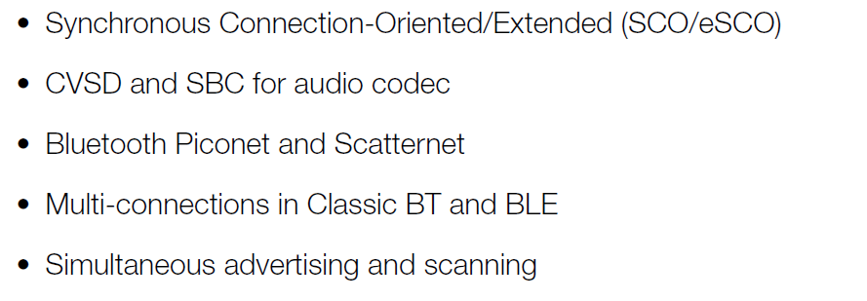
Bluetooth Key Features

Slide 15
CPU and Memory
• Xtensa® single-/dual-core 32-bit LX6 microprocessor(s), up to 600 MIPS (200 MIPS for ESP32-S0WD, 400 MIPS for ESP32-D2WD)
• 448 KB ROM
• 520 KB SRAM
• 16 KB SRAM in RTC
• QSPI supports multiple flash/SRAM chips Espressif

Slide 16
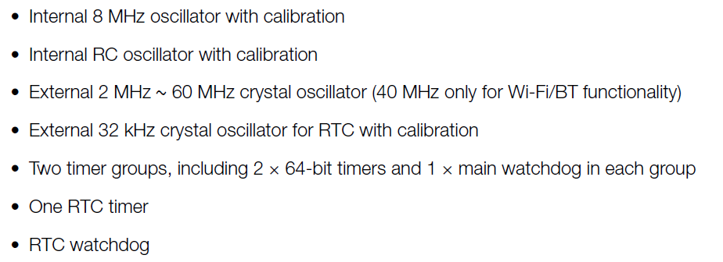
Clock and Timer

Slide 17
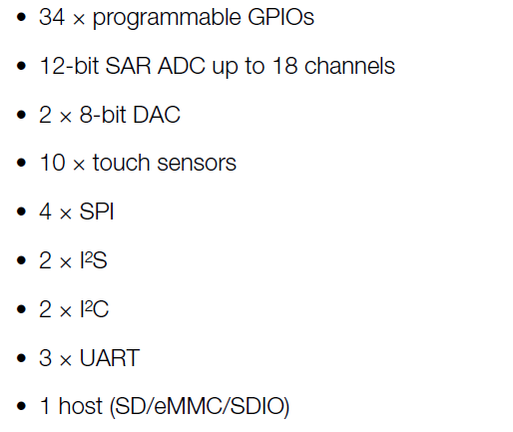
Peripherals

Slide 18
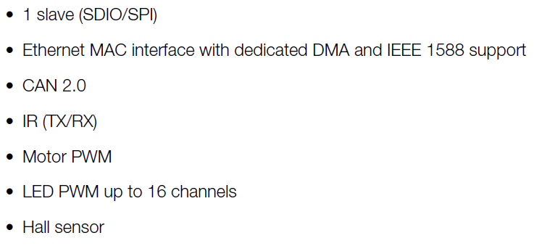
Peripherals

Slide 19
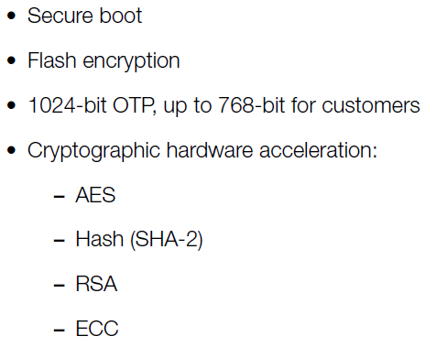
Security

Slide 20
ESP32 vs ESP8266 vs Arduino
 | ESP32 | ESP8286 | Arduino Uno R3
Core | 2, 32bit | 1, 32bit | 1, 8bit
Clock | 160 MHz | 80 MHz | 16 MHz
Wifi | Yes | Yes | No
Bluetooth | Yes | No | No
RAM | 512 KB | 160 KB | 2 KB
FLASH | 16 Mb | 16Mb | 32 KB
GPIO | 36 | 17 | 14
Interface | SPI/I2C/UART/I2S/CAN | SPI/I2C/UART/I2S | SPI/I2C/UART
ADC | 18 | 1 | 6
DAC | 2 | 0 | 0

Slide 21
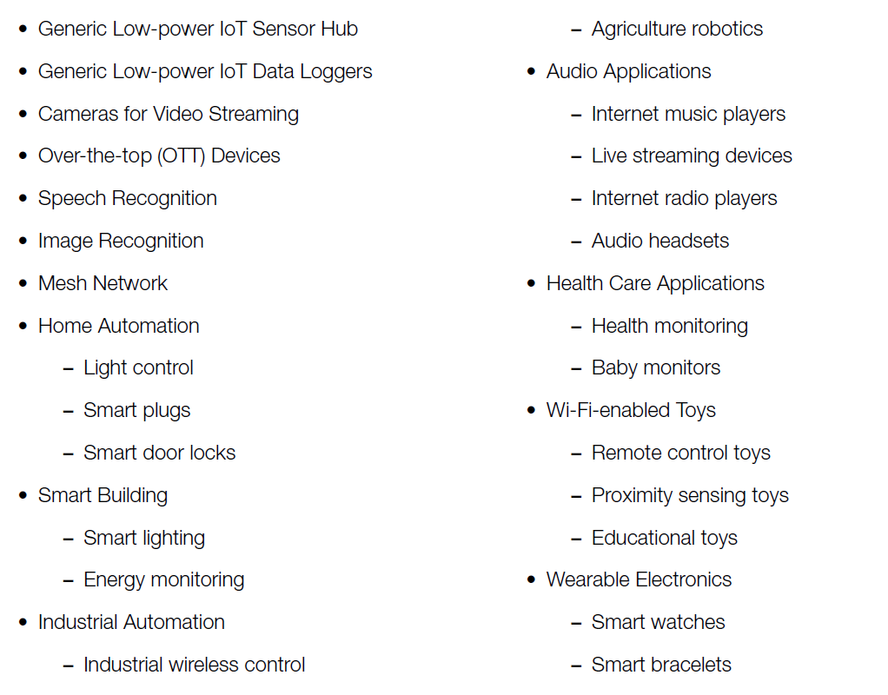
Applications

Slide 22
ESP Design Environment
Development environment
Programming languages, frameworks, platforms, and environments used for ESP32 programming: - Arduino IDE with the ESP32 Arduino Core - Espressif IoT Development Framework - Official Espressif development framework for ESP32. - Lua RTOS for ESP32 - Mongoose OS - PlatformIO Ecosystem and IDE - Pymakr - Simba Embedded Programming Platform - Whitecat Ecosystem Blockly Based Web IDE

Slide 23
ESP Design Environment
FreeRTOS
The ESP32 comes with a light operating system - FreeRTOS. The following methods to program this chip don’t replace the FreeRTOS firmware, but rather deploy applications for it to run.
ESP-IDF
Espressif IoT Development Framework is a set of open source libraries and tools to facilitate deployment of apps to ESP32s FreeRTOS. The esp-idf framework is based on the FreeRTOS Real-Time Operating System.
Arduino Core ESP32 Bootloader

Slide 24
Documents
1. ESP32 Series Datasheet, Version 3.0, Espressif Systems
Copyright © 2019.
2. Online guidance and Document:
https://www.espressif.com/en/products/socs/esp32/resources
3. Online discussion and forum:
http://esp32.net/
4. Others: Internet, Youtube…

Slide 25
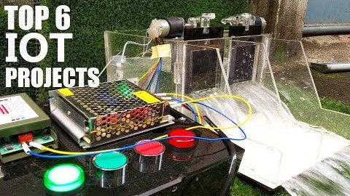
IoT to Life

Slide 26

Q&A

